Slide 1
Web Engineering
BY
Adnan Amin
IMSciences|Peshawar

Slide 2
Outlines
HTML Elements and Its Sequences
Meta data and elements
Redirecting a page
Paragraph
Headings
Horizontal Rule
Listing in HTML
Tables in HTML

Slide 3
HTML Elements and Its Sequences
The <html> tag starts the web page, and </html> ends it.
The markup between <head> and </head> defines general information for the entire web page.
The text inside the <title></title> element provides the page title.
The <meta> element provides information about page content and display layout.
A <link> element establishes a link to an external resource; in this case, to two different CSS style sheets.
The markup between <body> and </body> supplies actual page content.

Slide 4
HTML Elements and Its Sequences
The <div> </div> element defines two different content divisions on the page, one for navigation, the other for page content.
The navigation <nav> </nav> element defines a navigation bar.
The anchor <a> </a> element defines hypertext links.
The heading1 <h1> </h1> element defines a level-1 heading.
The paragraph <p> </p> element defines a paragraph of text.
A figure <figure> </figure> element defines a graphic with a caption.
The image <img> element links to a graphic for display, with horizontal and vertical dimensions and alternative text in case the image doesn’t appear.
A figure caption <figcaption> </figcaption> element labels the figure caption.
A document footer <footer> </footer> element defines text for the bottom of the page.

Slide 5
Meta Tag
Meta data means data or information about data.
Always appear inside the HTML <head>
To define the character encoding which represent character data inside HTML document.
To define keywords for search engines.
To define a document refresh interval.

Slide 6
Example: Use of <meta> tag in HTML
<html>
<head>
<meta charset=”UTF-8”> <!-- defines default HTML character codes -->
<meta name=”keywords” content=”HTML, CSS, meta tag examples”>
<meta name=”author” content=”Adnan”> <!-- identifies author -->
<meta name=”description” content=”meta element discussion -->
<meta http-equiv=”refresh” content=”1800”> <!-- refresh every 30 mins -->
<title>Naming your page with this tag</title>
</head>
<body></body>
</html>

Slide 7
Redirecting users to another page
<meta> element can be used to redirect page visitors to another targeted page automatically.
To use <meta> tag to send a message to the browser what to display.
For example:
if you’ve ever come across a page that reads This page has moved. Please wait 10 seconds to be automatically sent to the new location.(or something similar), you’ve seen this trick at work.
Use the following line inside your html head
<meta http-equiv=”refresh” content=”15; url=http://www.w3.org/”>

Slide 8
Refresh jump to www.imsciences.edu.pk after 15 seconds
<html>
<head>
<title>All About Markup</title>
<meta charset=”UTF-8”>
<meta http-equiv=”refresh” content=”15; url= www.imsciences.edu.pk
</head>
<body>
<p>This page is still in development. Until we are done, please visit
the <a href=” www.imsciences.edu.pk ”>IMS</a> for the definitive
collection of markup-related resources.
</p>
<p>Please wait 10 seconds to be automatically redirected to the W3C.</p>
</body>
</html>

Slide 9
Technical Caution
When redirecting a webpage some search engine see redirects in metadata, mostly they assume the webpage is trying to create spam which may also remove from the search engine listings.

Slide 10
Paragraph
To create a paragraph, follow these steps:
Add <p>in the body of the document.
Type the content of the paragraph.
Add </p>to close that paragraph.

Slide 11
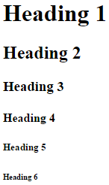
Headings
Headings break a document into different sections including main and sub sections.
To organize the document text structure
Break up the text flow on the page with different size of headings.
Provides visual view in pieces of contents in grouping.
Heading tags
<h1>Heading 1</h1>
<h2>Heading 2</h2>
<h3>Heading 3</h3>
<h4>Heading 4</h4>
<h5>Heading 5</h5>
<h6>Heading 6</h6>

Slide 12
<blockquote> element is use for enclose quotation
<body>
<h1>An Inspiring Quote</h1>
<p>Type here some text as a paragraph</p>
<blockquote>
type some text here to enclose quotations.
</blockquote>
</body>

Slide 13

Preformatted text element <pre>
The preformatted text <pre> tag instructs browsers to keep all white space intact while it displays your contents.
Example:
<pre>This is a paragraph
with a lot of white space
thrown in for fun (and as a test of course).
</pre>

Slide 14
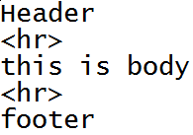
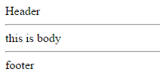
Horizontal rules
The <hr> element is used to draw solid straight lines called rules on your web page.
It also include Break on page.
It can be used for separate headers and footers from the rest of the page.

Slide 15

<hr width=”45%” size=”4” align=”center” noshade=”noshade”>
The following bit of HTML creates a horizontal rule that takes up 45 percent of the page width, is 4 pixels (px) high, is aligned to the center, and has shading turned off:

Slide 16
Lists in HTML
Lists are used to organize the information in proper order.
There are three types of lists.
Numbered lists
Bulleted lists
Definition lists

Slide 17

1. Numbered lists
A numbered list consists of prefaced number (digits) of each list item.
Lists use a combination of elements at least two;
<ol> ordered list element which specifies numbered list.
<li> item elements mark each item in the list.
Example:
<ol>
<li> body of 1st list item</li>
<li> body of 2nd list item</li>
</ol>

Slide 18

2. Bulleted Lists
A bulleted list contains one or more items each prefaced by a bullet (dot).
It requires at least two components;
<ul> unordered list element which specifies a bulleted list.
<li> list item marks wach item in the list.
Example:
<ul>
<li> Body of 1st item</li>
<li> Body of 2nd item</li>
</ul>

Slide 19
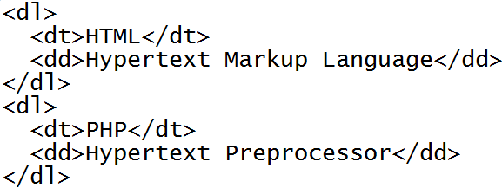

3. Definition Lists
Definition lists group the terms and definitions into a single list.
There are three elements to complete definition lists;
<dl> : definitions list
<dt>: definition term
<dd>: definition list definition
You can use many <dt> and <dl> as many you need it.

Slide 20
Lab Assignment
The output should look like this;
Things to do today.
BCS
Bachelor of Computer Science
Java
PHP
HTML
2. MCS
Master of Computer Science
OOP
Databases

Slide 21
Tables in HTML
Tables make it easy to layout the web page and data on webpage.
Easily can manage multiple images in a grid form using table.
Tables are also used to present tabular form of data similar to spreadsheets.
It consists of column and row.
Tables are used to manage what page looked like and where individual elements would appear. This technique proved especially useful for creating multicolumn page layouts and still used by many web page designers but CSS can handle such things more directly and easily now adays.

Slide 22
Table tag Markup
<caption> to define a caption for a table.
<colgroup> to define column groupings for a table.
<thead> to define the heading section for a table.
<tbody> to define actual contents for the table.
<tfoot> to provide information for the bottom of a table.
<tr> define table row for the data that table actually presents.
<td> or <th> use th for bold, centered column heads, use td for plain, left-justified heads.

Slide 23
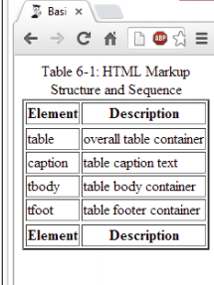
Table Example
<table border=”1”>
<caption>Table 6-1: HTML Markup Structure and Sequence</caption>
<thead><tr><th>Element</th><th>Description</th></tr> </thead>
<tbody>
<tr><td>table</td><td>overall table container</td></tr>
<tr><td>caption</td><td>table caption text</td></tr>
<tr><td>tbody</td><td>table body container</td></tr>
<tr><td>tfoot</td><td>table footer container</td></tr>
</tbody>
<tfoot><tr><td>Element</td><td>Description</td></tr> </tfoot>
</table>

Slide 24
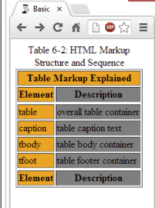
Example
<table border=”1”>
<caption>Table 6-1: HTML Markup Structure and Sequence</caption>
<colgroup>
<col style=”background-color: orange; font-size: 120%;”>
<col style=”background-color: gray; color: white;”
</colgroup>
<thead>
<tr> <th colspan=”2”>Table Markup Explained</th></tr>
<tr><th>Element</th><th>Description</th></tr>
</thead><tbody>
<tr><td>table</td><td>overall table container</td></tr>
<tr><td>caption</td><td>table caption text</td></tr>
<tr><td>tbody</td><td>table body container</td></tr>
<tr><td>tfoot</td><td>table footer container</td></tr>
</tbody>
<tfoot><tr><th>Element</th><th>Description</th></tr></tfoot>
</table>

Slide 25
Table layouts
Border: it specify the border size of the table edges.
Colspan: extends a cell to be as wide as 2 or more cells, can apply on td, th
Rowspan: extends a cell to be as tall as 2 or more cells, can apply on td, th
Cell padding: use to extends the spacing between text and table cells.
Cell spacing: use to extends the spacing between table cells.
Bgcolor: use to set the background color of table.
Align: use to set the table alignment on the web page i.e. center, left, right
Valign: use for vertical-align the text in the table i.e. top, middle, bottom
Width: use to set the table width.

Slide 26
Lab Assignment: Design a page look like as;
Header
 | Contents Place here | News Update _____________________
Footer
Main Menu
HOME
About Us
Contacts
Help

Slide 27
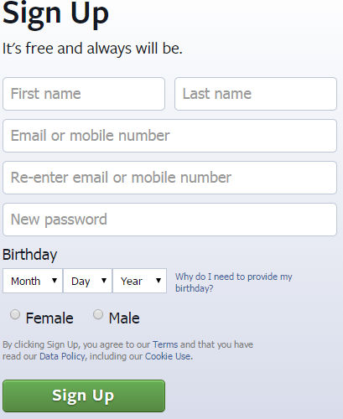
Forms in HTML
Use for dynamic web pages.
HTML can provides a collection of tags for creating forms that use to collect data/information from user.
<form>….</form> tags are used to create a form.
Example:

Slide 28
Attributes of form in html
<form action=“..” method=“..” target=“..”>
Action: the URL or path the page.
Method: how you want form data to be sent to the page which is mentioned in the action.
Get: sends the form data on the URL to the page which is mentioned in action.
Post: sends the form data in the HTTP to the page which is mentioned in the action.

Slide 29
Input fields in HTML form
Text field
Single line fields into which users type information.
Caption here <input type=“text” name=“t1” value=“type here” />
i.e. Caption here
Size: the length (in characters) of the text field.
Maxlength: the maximum number of characters the user can type into the field.
Password field
A password field is a special text field that doesn’t display (i.e. asterisk or bullet) what the user types.
Enter Password <input type=“password” name=“t2” size=“10” maxlength=“25”>
e.g. Enter Password
*****************

Slide 30
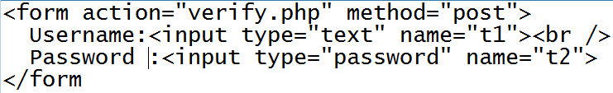

Example:

Slide 31
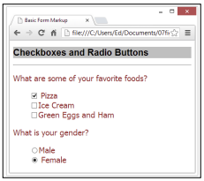
Check boxes and Radio buttons
If a finite set of possible values is available to the user then check boxes or radio buttons are used.
Check boxes: choose more than one option.
Radio buttons: choose only one option.

Slide 32

Example: Radio Button
<form>
<input type=“radio” name=“gender” value=“male”> Male <br />
<input type=“radio” name=“gender” value=“female”> Female
</form>

Slide 33

Example: Check boxes
<form>
<input type=“checkbox” name=“c1” value=“Pizza” checked=“checked”><br>
<input type=“checkbox” name=“c2” value=“icecream”> Ice Cream<br>
<input type=“checkbox” name=“c2” value=“icecream”> Green Eggs and Ham<br>
</form>

Slide 34
Hidden Field
A hidden field lets you collect name and value information that the user cannot see along with the rest of the form data.
Hidden fields are useful for keeping track of information associated with the form.
Usually used in dynamic web page programming e.g. PHP to send primary key or id along with the other form data to target page for necessary action.
<input type=“hidden” name=“h1” value= “adnan.amin@live. co.uk ”>

Slide 35
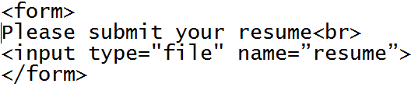

File upload field
A form can receive a document/file i.e. images, file etc.
A user can submit the form data (text and files or image)
The input element of form with type file is used for this purpose.

Slide 36


Drop-down List field
Drop down lists are a great way to give users lots of options in a small amount of screen space.
You can also allow users to select more than one item from the drop down list by holding Ctrl key.
Example: with multiple without multiple
Select Option
<select name=“s1” multiple=“multiple”>
<option value=“v1”>Value 1</option>
<option value=“v2”>Value 2</option>
</select>

Slide 37
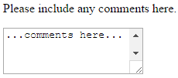
Multiline text boxes
When single line text field cannot fulfil the requirement of taking information as input from the user then multiline text boxes can be used.
Use the <textarea> element which defines the box to accept multi-line input from the users.
<textarea> have two important attributes
Rows: this attribute specifies the height of the box in rows based on the font in the text box.
Cols: this attribute specifies the width of the box in column based on the font in the text box.
<p> Please include any comments here.</p>
<textarea rows=”10” cols=”40” name=”comments”>
...comments here...
</textarea>

Slide 38
Submit and Reset Buttons
These are action buttons which tell the browser what to do with the form either send the data or clear the form.
The submit button is used which tell the browser we have done the job with form and now want to send the form contents for further action.
i.e. <input type=“submit” value=“submit”>
The reset button is used which tell the browser that we want to start all over again or decide not to submit yet.
I.e. <input type=“reset” value=“Clear”>

Slide 39
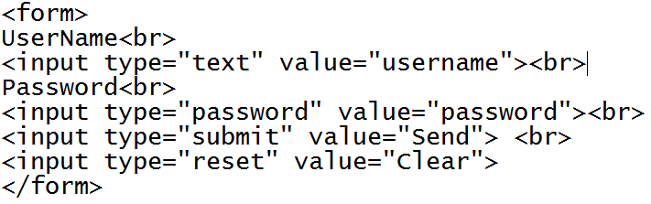
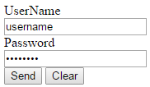
Example

Slide 40
Form Validation
There is always a chance for entering data in wrong format or perhaps leave some important field unfilled.
Form validation is the process of checking data the user enters before it’s put into your database.
For validation can be apply to check the input data either with local JavaScript or PHP scripts on server.
Javascript validate the input data before data goes to the server at client side. (Quick process, user will not wait for server response).
Sometime user or browser setting block the JavaScript features and user suffer therefore PHP can also validate the data on server without user or browser interruption. (Slow process, user will must wait for server response)

Slide 41
Hyperlinks in HTML
Links or hyperlinks, connect HTML pages and other resources on the web site.
It enable users to travel or navigate from one page to another page or from one website to another on your site.
<a> Anchor tag is used with hyperlink page.
Example:
<a href=“contact.html” target=“_blank”>Contact Us</a>
Href=“protocol:hostname/directory path.extension”
Target: attribute is used to anchor element opens that link in a new browser window or in current windows.

Slide 42
Naming link locations on web page
To identify and create a location within a page for direct access from other links, use an empty anchor element with the name attribute.
i.e. <a name=“top”></a>
Now linking within the same page which help users to navigate a single webpage or inter-document hyperlinks.
i.e. <a href=“#top”>Back to top</a>

Slide 43
Images in HTML
Usually web designers use images to deliver important information, direct site navigation and contribute to overall look and feel on a web page.
Role of images on web
Logos
Clickable navigation aids
Advertisements
Eye catch bahaviors
Headers
Footers
Page designs
Web Friendly Images
GIF (Graphics Interchange Format) 256 colors only, lose image quality, faster to open, icons
JPEG (Joint Photographic Experts Group) 24bit color (million of color), photographs
PNG (Portable Network Graphics) 32bit color, best balance b/w quality and file size

Slide 44
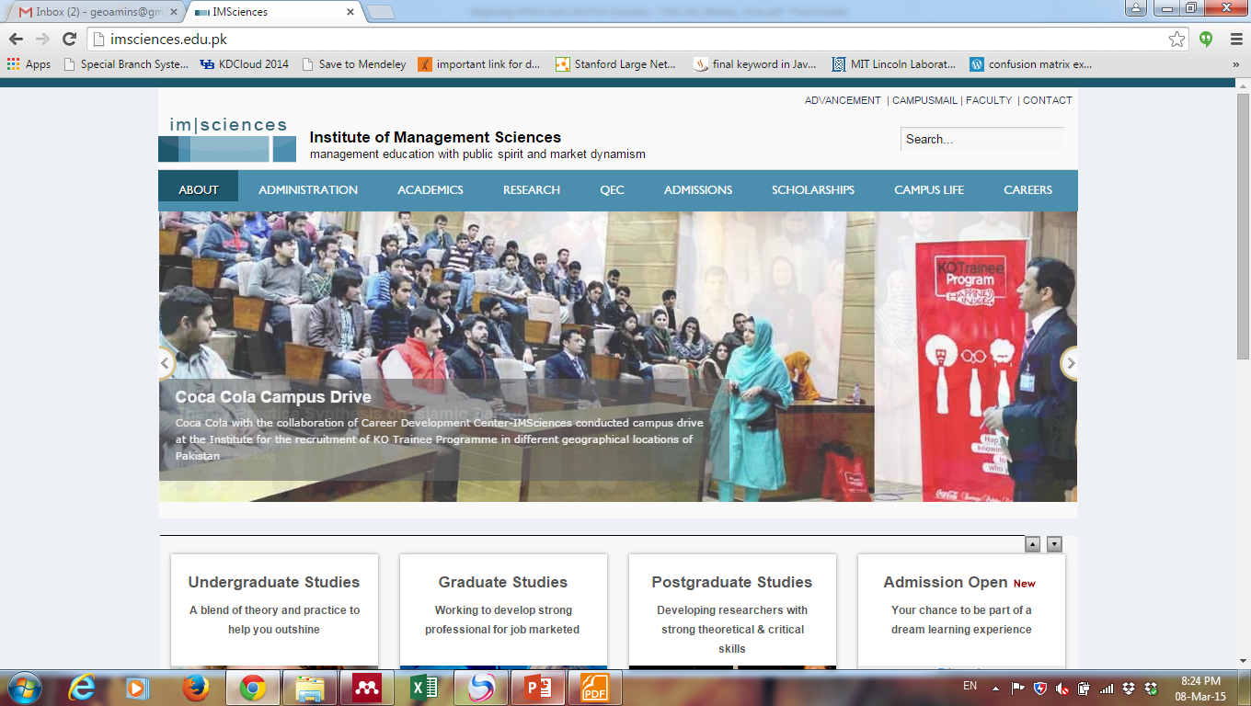

Slide 45
Adding image on web page
<img src=“image path” alt=“tooltip text” height=“ “ width=“ “ />
Src: path of image source. It is just like href attribute. SRC specifies the location for the image you want to display on web page.
Image that link to another page
<a href=“www.imsciences.edu.pk” >
<img src=“imslogo.gif” />
</a>

Slide 46
Image maps & linking
Image map is markup to map the different regions on the map to different URLs.
<img src=“Pakistan.png” usemap=“#Navigate”>
<map name=“Navigate”>
<area shape=“rect” coords=“0.0.99.30” href=“kpk.html”>
<area shape=“rect” coords=“102.0.202.30” href=“Panjab”>
<area shape=“rect” coords=“202.0.301.30” href=“Sindh”>
…..
</map>

Slide 47
Media in HTML
Web is embracing an ever-widening array of meida such as
Audio
Video
Streaming media
For audio (format: ogg, MP3, WAV)
<audio controls preload=”none” loop>
<source src=”sound.ogg” type=”audio/ogg”>
<source src=”sound.wav” type=”audio/x-wav”>
<source src=”sound.mp3” type=”audio/mpeg”>
<p>Browser does not support HTML5 audio; alternate playback provided.</p>
</audio>
Autoplay: tells the browser to start playing audio as soon as the object file is loaded. i.e. autoplay=”autoplay”
Controls: tells the browser to display (Pause/Play button, progress bar and volume). i.e. controls=“controls”

Slide 48
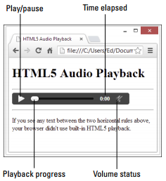
Loop: tells the browser to go back to the beginning and keep playing when it gets to the end of the object file. i.e. loop=“loop”
Preload: tells the browser whether it should preload the object file and if so how it should be preloaded;
None: doesn’t load any part of the audio file when the page loads.
Metadata: loads only the audio metadata when the page loads. It also sets up playback but doesn’t have data loaded yet.
Auto: loads entire audio file when the page loads.
The preload attribute is ignored if autoplay is present.

Slide 49
Thanks!
Source Book
Beginning HTML 5 and CSS3 – Tittel, Ed, Minnick, Chris

